Slide 1
ALL INDIA SHRI SHIVAJI MEMORIAL SOCIETY'S IOIT PUNE - 411001
GROUP ID – 19
PROJECT TITLE
SECURE DATA STORAGE ON MULTI-CLOUD USING DNA BASED CRYPTOGRAPHY
INTERNAL GUIDE
Mrs. D.S.ZINGADE
NAME | SEAT No.
DHURI SAGAR VITHAL | B80254217
NAIKADE PRAKASH KONDIBHAU | B80254245
NILESH BALKRISHNA GADE | B80254249
TEKE ABHIJEET BHAGWAN | B80254276

Slide 2
PROBLEM DEFINITION
The main target of this project is to propose an algorithm to implement data hiding in DNA sequences to increase the confidentiality and complexity by using software point of view in multi-cloud computing environments.
Keywords: DNA sequence, Cloud Computing, Multi-cloud Architecture.

Slide 3
MOTIVATION OF THE PROJECT
MULTI-CLOUD ARCHITECTURE
Cloud computing has a great capability to boost productivity and minimize costs.
Hence many users are embracing it, but at the same time it constitutes many security risks and challenges.
Due to possibilities of multiple risks such as service outage, theft of data, data leakage and the chances of malicious insider attack, using single cloud is becoming obnoxious by many users.
Therefore, new notion of Multi-Clouds usage is becoming perceptible to cope with these security issues.

Slide 4
DNA BASED CRYPTOGRAPHY
One of the famous ways to protect data through the Internet is data hiding.
The common way of embedding a secret data into the host images was the traditional way of data hiding.
It unfortunately leads to some liabilities such as detection of the distortions of the image when the host image changed to some degrees.
New data hiding methods have been proposed by researchers, based on DNA sequences. The key portion of their work is, utilizing biological characteristics of DNA sequences.

Slide 5
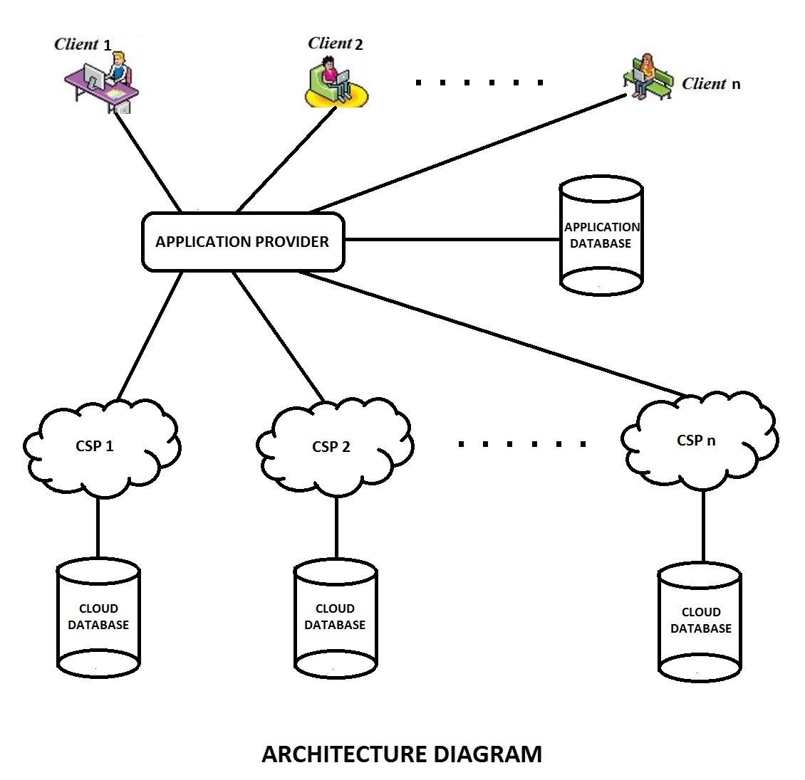
BLOCK DIAGRAM OF PROJECT

Slide 6
DESIGN OF PROJECT
MATHEMATICAL MODEL:
S : System
S = { U , A , C }
Where,
U : End – Users.
U = {U₀ , U_{1 ,} . . . , U_{n }} for n clients.
A is Application Server.
C : Cloud Service Provider.
C = {C₀ , C_{1 ,} . . . , C_{m}} for m cloud service provider.

Slide 7
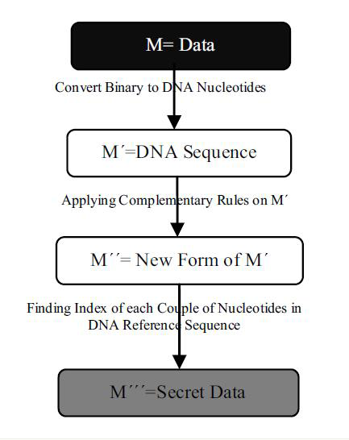
ALGORITHM AND TEST CASES
1] Message Encryption Phases:
M : Original Binary message
M’ : Phase – 1 encrypted Message
M’’ : Phase – 2 encrypted Message
M’’’ : Phase – 3 encrypted Message (Final Encrypted Message)

Slide 8
Phase 1 Encryption:
_{eof}
M’ = ∑_{start} (encode1(d))
where,
encode1 : Function returning DNA nucleotide for set d.
d : {(d1,d2) | d1,d2 are 2 consecutive bits of M}.
Phase 2 Encryption:
_{eof}
M’’ = ∑_{start} (encode2(x))
where,
encode2 : Function returning DNA nucleotide compliment for set x.
x is every DNA Nucleotide of M’.
Phase 3 Encryption:
_{eof}
M’’’ = ∑_{start} (encode3(g))
where,
encode3 : Function returning indexes for DNA pair.
g : {(g1,g2) | every DNA pair of M’’}.

Slide 9
Testing Message Encryption Phases:
DNA Reference Sequence:
AT₁CG₂AA₃TT₄CG₅CG₆CT₇GA₈GT₉CA₁₀CA₁₁AT₁₂TC₁₃GC₁₄GC₁₅TG₁₆AG₁₇TG₁₈AA₁₉CC₂₀
M=100111000011
Sub-phase1_{(A= 00, T= 01, C= 10, G= 11)}: M´= CTGAAG
Sub-phashe2_{((AC) (CG) (GT) (TA))}: M´´= GATCCT
Sub-phase3_{(Indexes)} : M´´´=8137

Slide 10
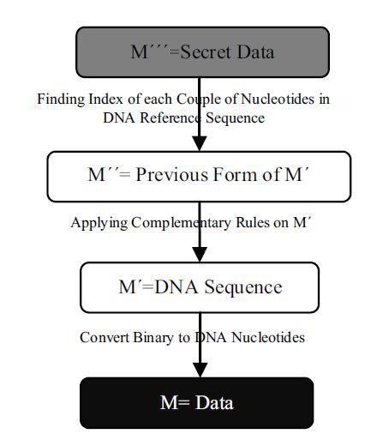
2] Message Decryption Phases:
M’’’ : Decrypted Message
M’’ : Phase – 1 Decrypted Message
M’’ : Phase – 2 Decrypted Message
M’ : Phase – 3 Decrypted Message (Original Message)

Slide 11
Phase 1 Decryption:
_{eof}
M’’= ∑_{start} (decode1(g))
where,
decode3 : Function returning DNA pair for indexes .
g : Every index from M’’’.
Phase 2 Decryption:
_{eof}
M’ = ∑_{start} (decode2(x))
where,
decode2 : Function returning DNA nucleotide compliment for set x.
x is every DNA Nucleotide of M’’.
Phase 3 Decryption:
_{eof}
M = ∑_{start} (decode1(d))
where,
decode1 : Function returning pair of binary digits for d.
d is every DNA Nucleotide of M’.

Slide 12
Testing Message Decryption Phases:
DNA Reference Sequence:
AT₁CG₂AA₃TT₄CG₅CG₆CT₇GA₈GT₉CA₁₀CA₁₁AT₁₂TC₁₃GC₁₄GC₁₅TG₁₆AG₁₇TG₁₈AA₁₉CC₂₀
M´´´=8137
Sub-phase1_{(Indexes)} : M´´= GATCCT
Sub-phashe2_{((CA) (GC) (TG) (AT))}: M´= CTGAAG
Sub-phase3_{(A= 00, T= 01, C= 10, G= 11)} : M=100111000011

Slide 13
FEASIBILITY ANALYSIS:
The mathematical model obtained gives the solvable output for proposed system. But the time depends on the positions of the base pairs in the reference string. So we conclude that our system lies in NP-complete.

Slide 14
MODULES & FUNCTIONALITY
CLIENT
The system designed will consist of three module:
Client
Application Provider (Server)
Cloud Service Provider (CSP)
APPLICATION PROVIDER
(Server)
CLOUD SERVICE PROVIDER
(CSP)

Slide 15
Functionality Of Client :-
Client are end users of the application. The application installed on end user system will constitute the following
functionality.
New client can register.
Existing client can log in.
Client is be able to upload file in encrypted form.
Client is able to retrieve file already stored and decrypt the file.
Client can also delete file already stored on cloud.
Client can update its profile.
Beside this every client holds its own private key.

Slide 16
Functionality Of Application Provider :-
Application provider is the bridge between client and cloud service provider. Server is centralised processor for the system. It is responsible for successful execution of the system. The main functionality of the system are:
Authenticate users.
Database of user details and their private key.
Space allocation.
Storage space calculation.
File segmentation.
Receive and execute requests from client in form of upload and retrieve.
Record of clouds and files stored over these clouds.

Slide 17
Functionality Of Cloud Service Provider :-
Cloud Service Provider are the authorities holding storage space of its own for public use.
Cloud service provider is the admin of the cloud storage space.
It can save file sent to it through authorised user.
It can retrieve file stored to the authorised user.

Slide 18
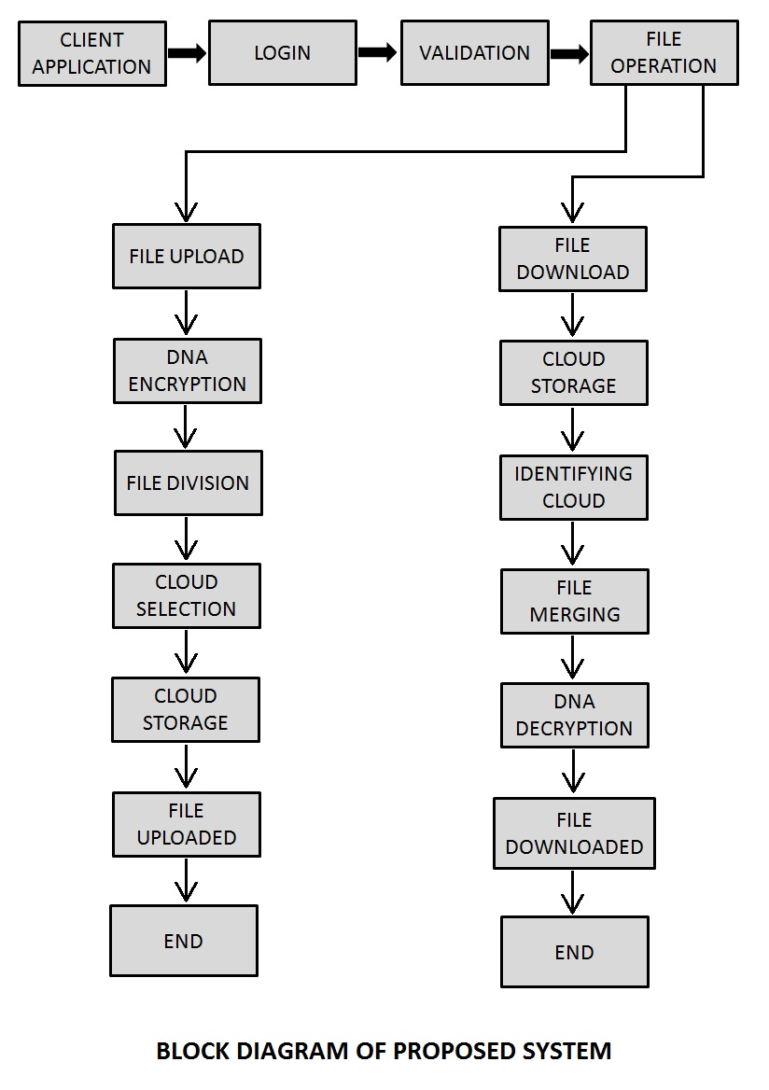
FUNCTIONAL FLOW OF SYSTEM :

Slide 19
SECURITY MEASURES
In terms of security, each intruder must be aware from the following information, correctly. Without this fundamental information, possibility of extracting original data is near to zero, scientifically.
DNA reference sequence: There are 163 million DNA reference sequence on EBI database. Therefore, the likelihood of making a doing well conjecture by attacker is 1 / (163 million).
Binary coding rule: Clients are free to select any equivalent binary form for every nucleotide. It means that, A can be “00‟, “01‟, “10‟, or “11‟; C can be “00‟, and so on. In other words, all the binary coding rules are 4×3×2×1=24. So, the likelihood of making correct guess by attacker is 1 /24.
Complementary pairing rule: Like binary coding rule, there is 4×3×2×1=24 complementary alphabet among basic nucleotides. Therefore, the possibility of making successful attack is 1 / 24.
Eventually, the final probability of making a correct and successful guess by attacker is 1 / (24 * 24 * 163 million)

Slide 20
CONSTRAINTS/LIMITATIONS
Implementation Constraints:
Error : Error should be easily recognized and get solved out.
Exception: All kind of exception should be handling properly.
Design Constraints:
This software would be designed to work only on Linux and Windows platform using MySQL database.

Slide 21
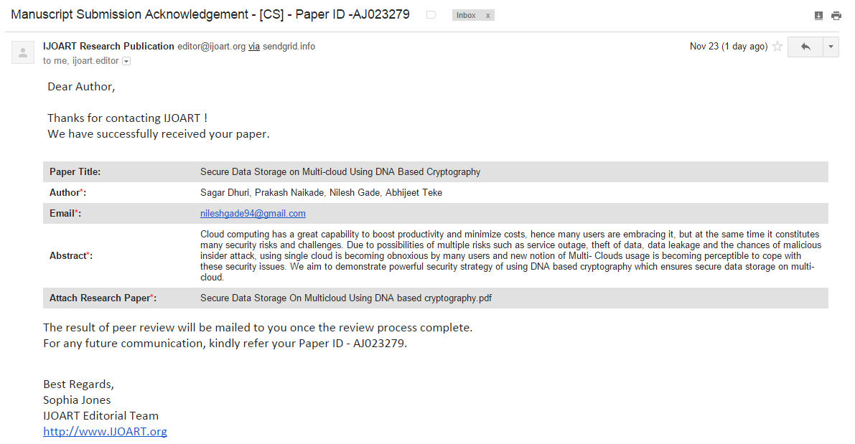
PAPER SUBMISSION DETAILS

Slide 22
ANY QUESTIONS ?

Slide 23
THANK YOU

